Slide 1

6th Grade Accelerated Math
Unit 14, Lesson 3 Discovering Inverse Operations Volume 2, pg. 347

Slide 2


Benchmark
MA.6.AR.2.2
Write and solve one-step equations in one variable within a mathematical or real-world context using addition and subtraction, where all terms and solutions are integers.
volume 2, pg. 347

Slide 3
Integrated Mathematical Thinking and Reasoning Standards
MA.K12.MTR.1.1 Actively participate in effortful learning both individually and collectively.
MA.K12.MTR.2.1 Demonstrate understanding by representing problems in multiple ways.
MA.K12.MTR.4.1 Engage in discussions that reflect on the mathematical thinking of self and others.
MA.K12.MTR.5.1 Use patterns and structure to help understand and connect mathematical concepts.
MA.K12.MTR.6.1 Assess the reasonableness of solutions.
volume 2, pg. 347

Slide 4

Learning Targets
I can use manipulatives to discover the role of inverse operations when solving one-step addition and subtraction equations.
I can solve addition and subtraction one-step equations in one variable using manipulatives, drawings, and number lines to show the inverse operations.
volume 2, pg. 347

Slide 5

Warm-Up
volume 2, pg. 348

Slide 6
14.3.1 Warm-Up: Picture This
Dale is helping to fix the roof at his uncle’s house. They are using a 40-foot ladder. Dale is climbing the ladder to reach the roof. He is currently 7 feet up the ladder.
Sketch a picture to represent this situation.
How much farther does Dale have to go to reach the roof? Include units.
volume 2, pg. 348

Slide 7

Exploration
volume 2, pg. 348

Slide 8




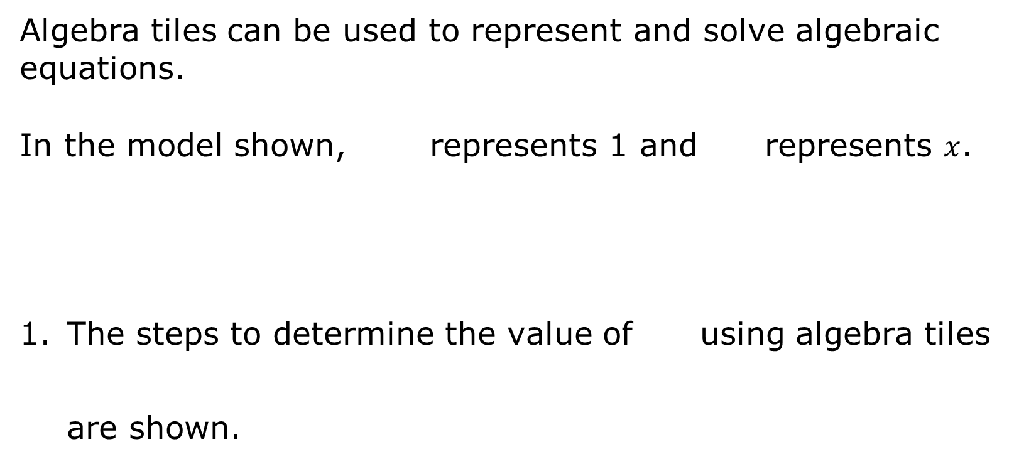
14.3.2 Exploration: Solving Equations Using Algebra Tiles
Algebra tiles can be used to represent and solve algebraic equations.
In the model shown, represents 1 and represents $x$.
The steps to determine the value of using algebra tiles are shown.
volume 2, pg. 348

Slide 9
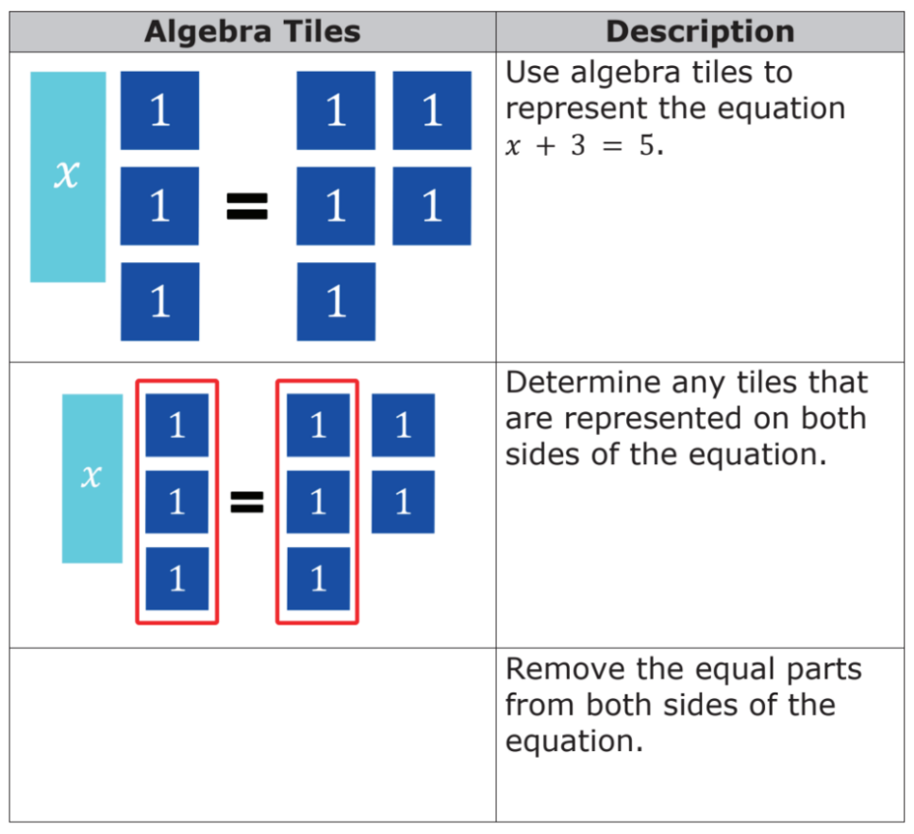
Work with your partner to complete the last step according to the description.
volume 2, pg. 348

Slide 10
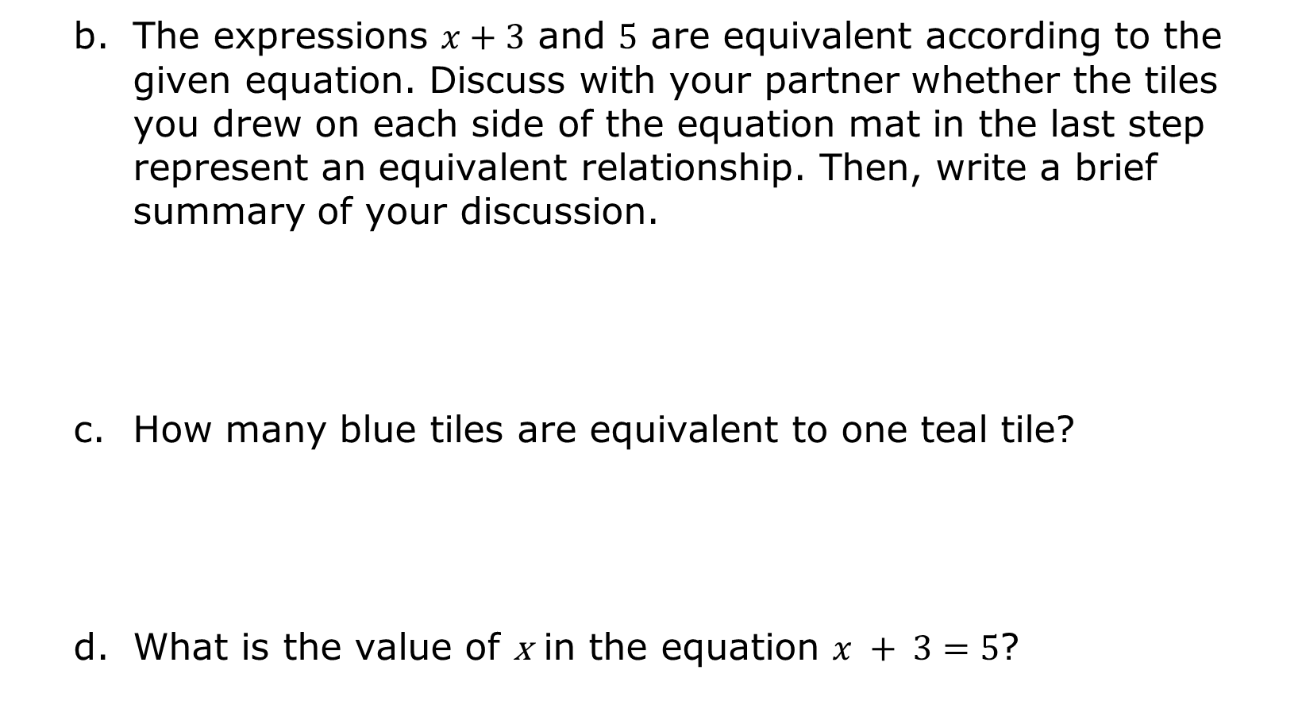
The expressions $x+3$ and $5$ are equivalent according to the given equation. Discuss with your partner whether the tiles you drew on each side of the equation mat in the last step represent an equivalent relationship. Then, write a brief summary of your discussion.
How many blue tiles are equivalent to one teal tile?
What is the value of x in the equation $x + 3=5$?
volume 2, pg. 349

Slide 11


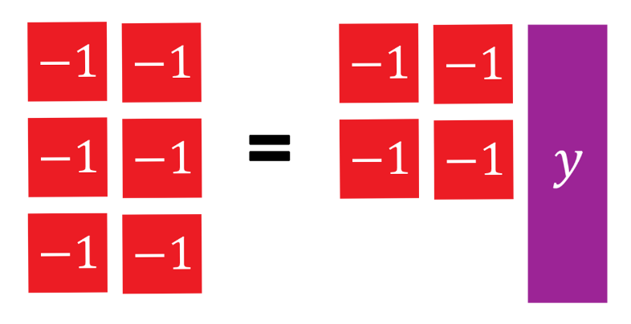

In the model shown, represents $−1$ and represents $y$.
Work with your partner to determine how many red tiles are equivalent to one purple tile.
What is the value of $y$ in the equation $−6 = −4 + y$?
volume 2, pg. 349

Slide 12

Guided Instruction
volume 2, pg. 350

Slide 13
14.3.3 Guided Instruction: Solving Equations Using Inverse Operations
An equation relates two equivalent expressions. When solving an equation, the mathematical sentence must remain balanced so that the two expressions remain equivalent.
Discuss with your partner what it means for an equation to remain balanced. Then, summarize your discussion.
When finding the solution to an equation, inverse operations are used to balance an equation.
volume 2, pg. 350

Slide 14
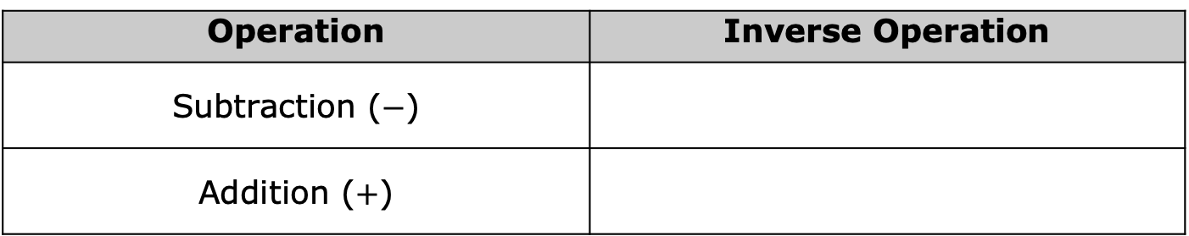
An inverse operation is an operation that reverses the effect of another operation.
Using the definition of inverse operations, complete the table to indicate which operation would reverse the given operation
Operation | Inverse Operation
Subtraction ($−$)
Addition ($+$)
volume 2, pg. 350

Slide 15



14.3.4 Guided Instruction: Solving Equations with Inverse Operations
Bar models and balance scales are useful tools for representing equations.
In the bar model shown, each palm tree represents $1$ unit.
The bar model can be used to represent either an addition or subtraction equation. Fill in the missing values in each equation to match the bar model.
$$3+______ = 8$$
$$8 − 3 = ______$$
volume 2, pg. 350

Slide 16
The bar model shown can be used to represent either an addition or subtraction equation.
Circle the addition equation that matches the diagram.
7
x
4
$$x+7=4$$ | $$7=x+4$$ | $$x=7+4$$
volume 2, pg. 350

Slide 17
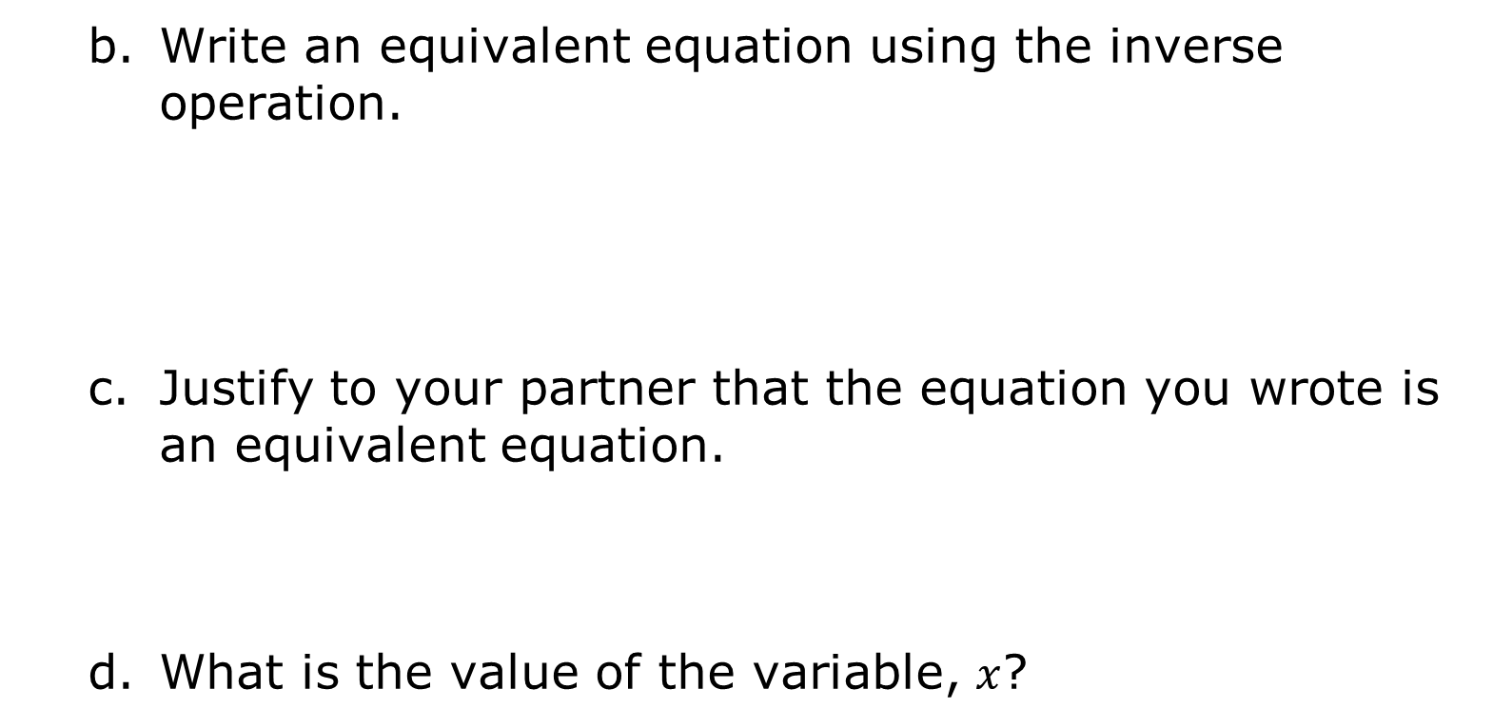
Write an equivalent equation using the inverse operation.
Justify to your partner that the equation you wrote is an equivalent equation.
What is the value of the variable, $x$?
volume 2, pg. 351

Slide 18
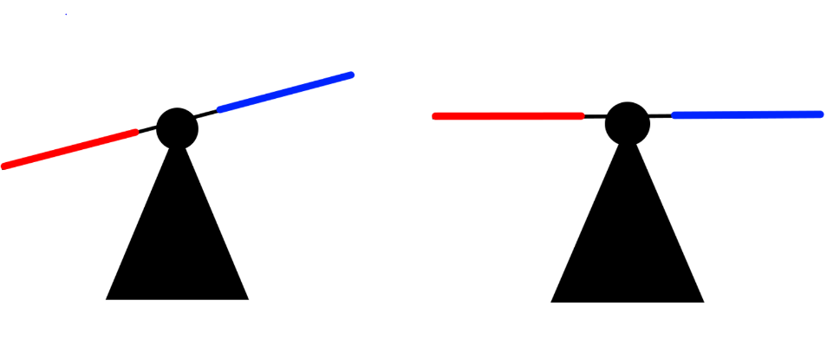
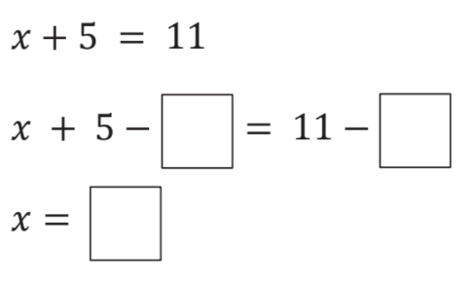

Two balance scales are shown. The scale on the left is unbalanced. To balance the scale, an unknown value, $x$, needs to be added to the right side of the scale.
The equation represented by the balance scale on the right is shown. Use inverse operations to find the value of $x$ by completing the steps shown.
5
11
5 + x
11
volume 2, pg. 351

Slide 19

Rewrite the original equation, substituting the solution for $x$.
Explain how to use the equation in Part B to confirm that your solution is correct.
volume 2, pg. 351

Slide 20

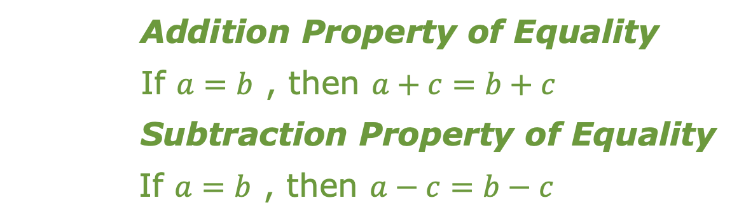
Inverse operations can be used to find the value of the variable in an algebraic equation by creating equivalent equations.
Addition Property of Equality
If $a=b$ , then $a+c=b+c$
Subtraction Property of Equality
If $a=b$ , then $a−c=b−c$
volume 2, pg. 352

Slide 21
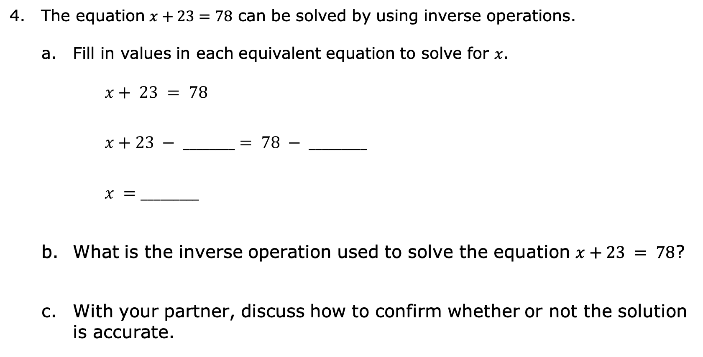
The equation $x+23=78$ can be solved by using inverse operations.
Fill in values in each equivalent equation to solve for $x$.
$$x+ 23 = 78$$
$$x+23 − ________= 78 − _________$$
$$x =_________$$
What is the inverse operation used to solve the equation $x+23 = 78$?
With your partner, discuss how to confirm whether or not the solution is accurate.
volume 2, pg. 352

Slide 22

Your Turn
volume 2, pg. 352

Slide 23
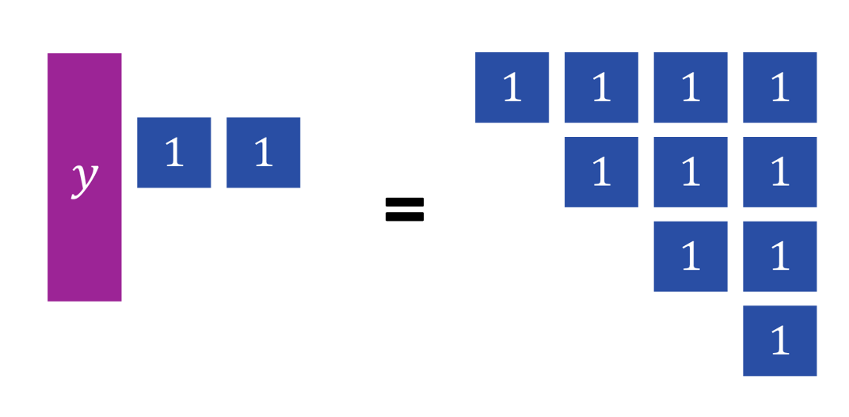
14.3.5 Your Turn!
The algebra tiles below model an equation.
How many blue tiles are equivalent to one purple tile?
volume 2, pg. 352

Slide 24
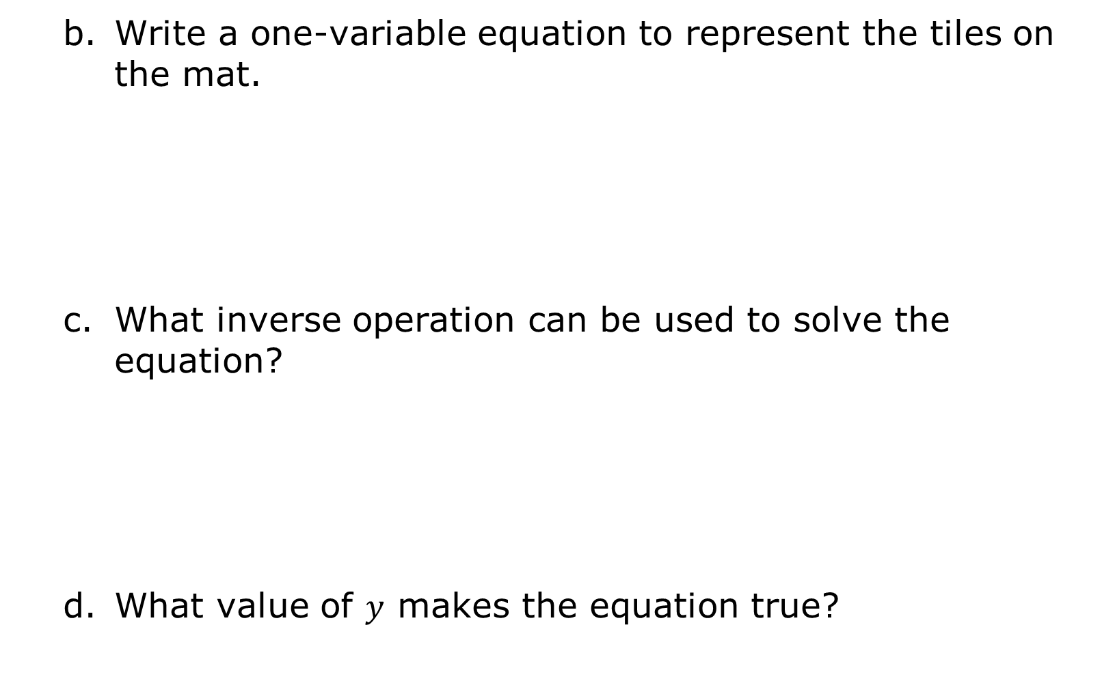
Write a one-variable equation to represent the tiles on the mat.
What inverse operation can be used to solve the equation?
What value of $y$ makes the equation true?
volume 2, pg. 352

Slide 25
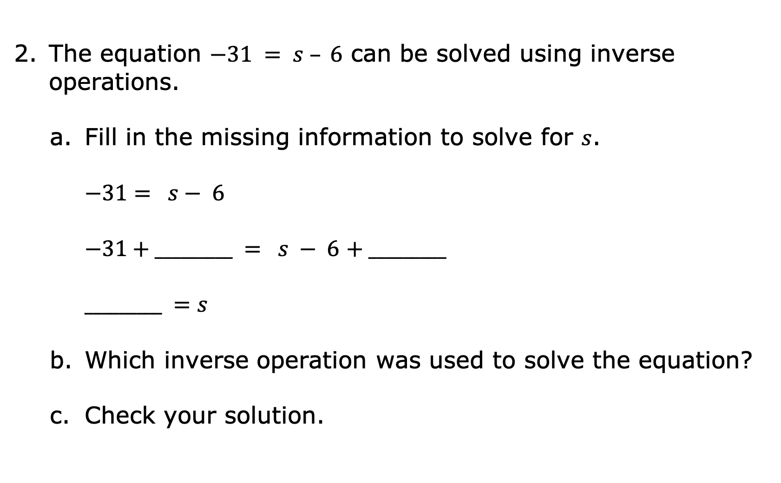
The equation $−31 = s – 6$ can be solved using inverse operations.
Fill in the missing information to solve for $s$.
$$−31= s− 6$$
$−31+_________ = s − 6$ $+ _________$
$$_________ =s$$
Which inverse operation was used to solve the equation?
Check your solution.
volume 2, pg. 353

Slide 26
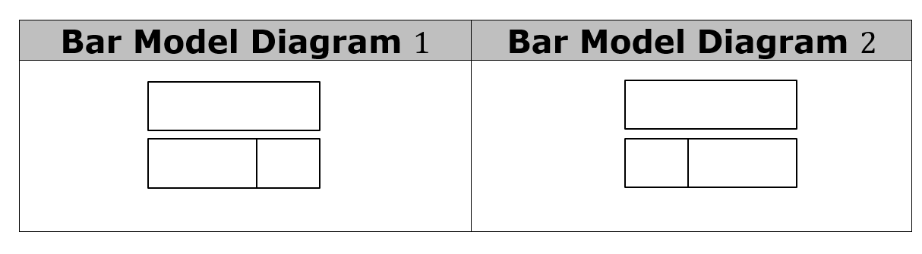
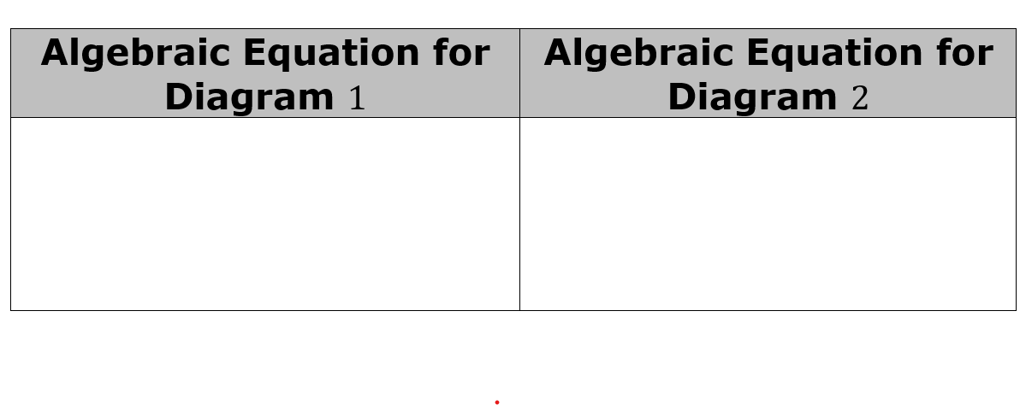






Two bar model diagrams are shown.
Write an algebraic equation for each diagram box diagram.
$$m$$
$$−12$$
$$−12$$
$$−4$$
$$4$$
$$m$$
volume 2, pg. 353

Slide 27
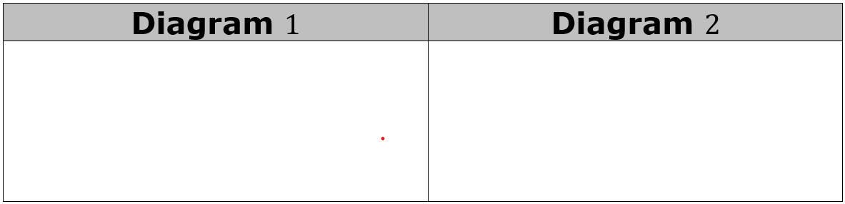

Find the value of variable, $m$, for each algebraic equation.
Discuss with your partner what you notice about the two equations. Summarize your discussion.
volume 2, pg. 353

Slide 28

Wrap-Up
volume 2, pg. 354

Slide 29
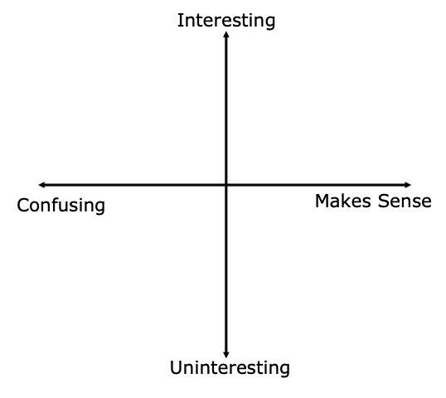
14.3.6 Wrap-Up: Reflection
Plot a point to indicate how you feel about today’s learning target: “I can use diagrams and inverse operations when solving one-step addition and subtraction equations.”
volume 2, pg. 354

